Slide 1


भवन निर्माण पूर्वअनुमतिका लागि प्रस्तुतीकरण
प्रोजेक्टको नाम:
प्रस्ताव पेश गरिएको निकाय
प्रदेश सरकार
भौतिक पूर्वाधार विकास मन्त्रालय
कोशी प्रदेश, विराटनगर
प्रस्तावकको नाम:
ठेगाना:
कन्सल्टेन्सीको नाम:
ठेगाना:
मिति: २०८२/२/३
सोमबार

Slide 2

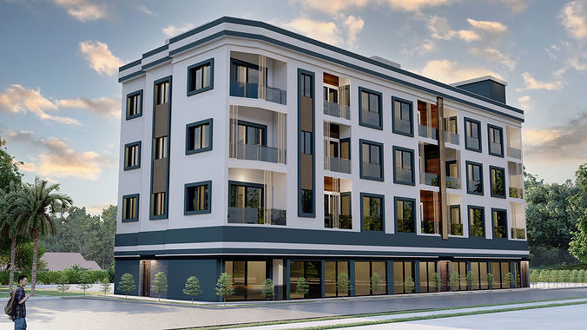
3D View of Building….

Slide 3
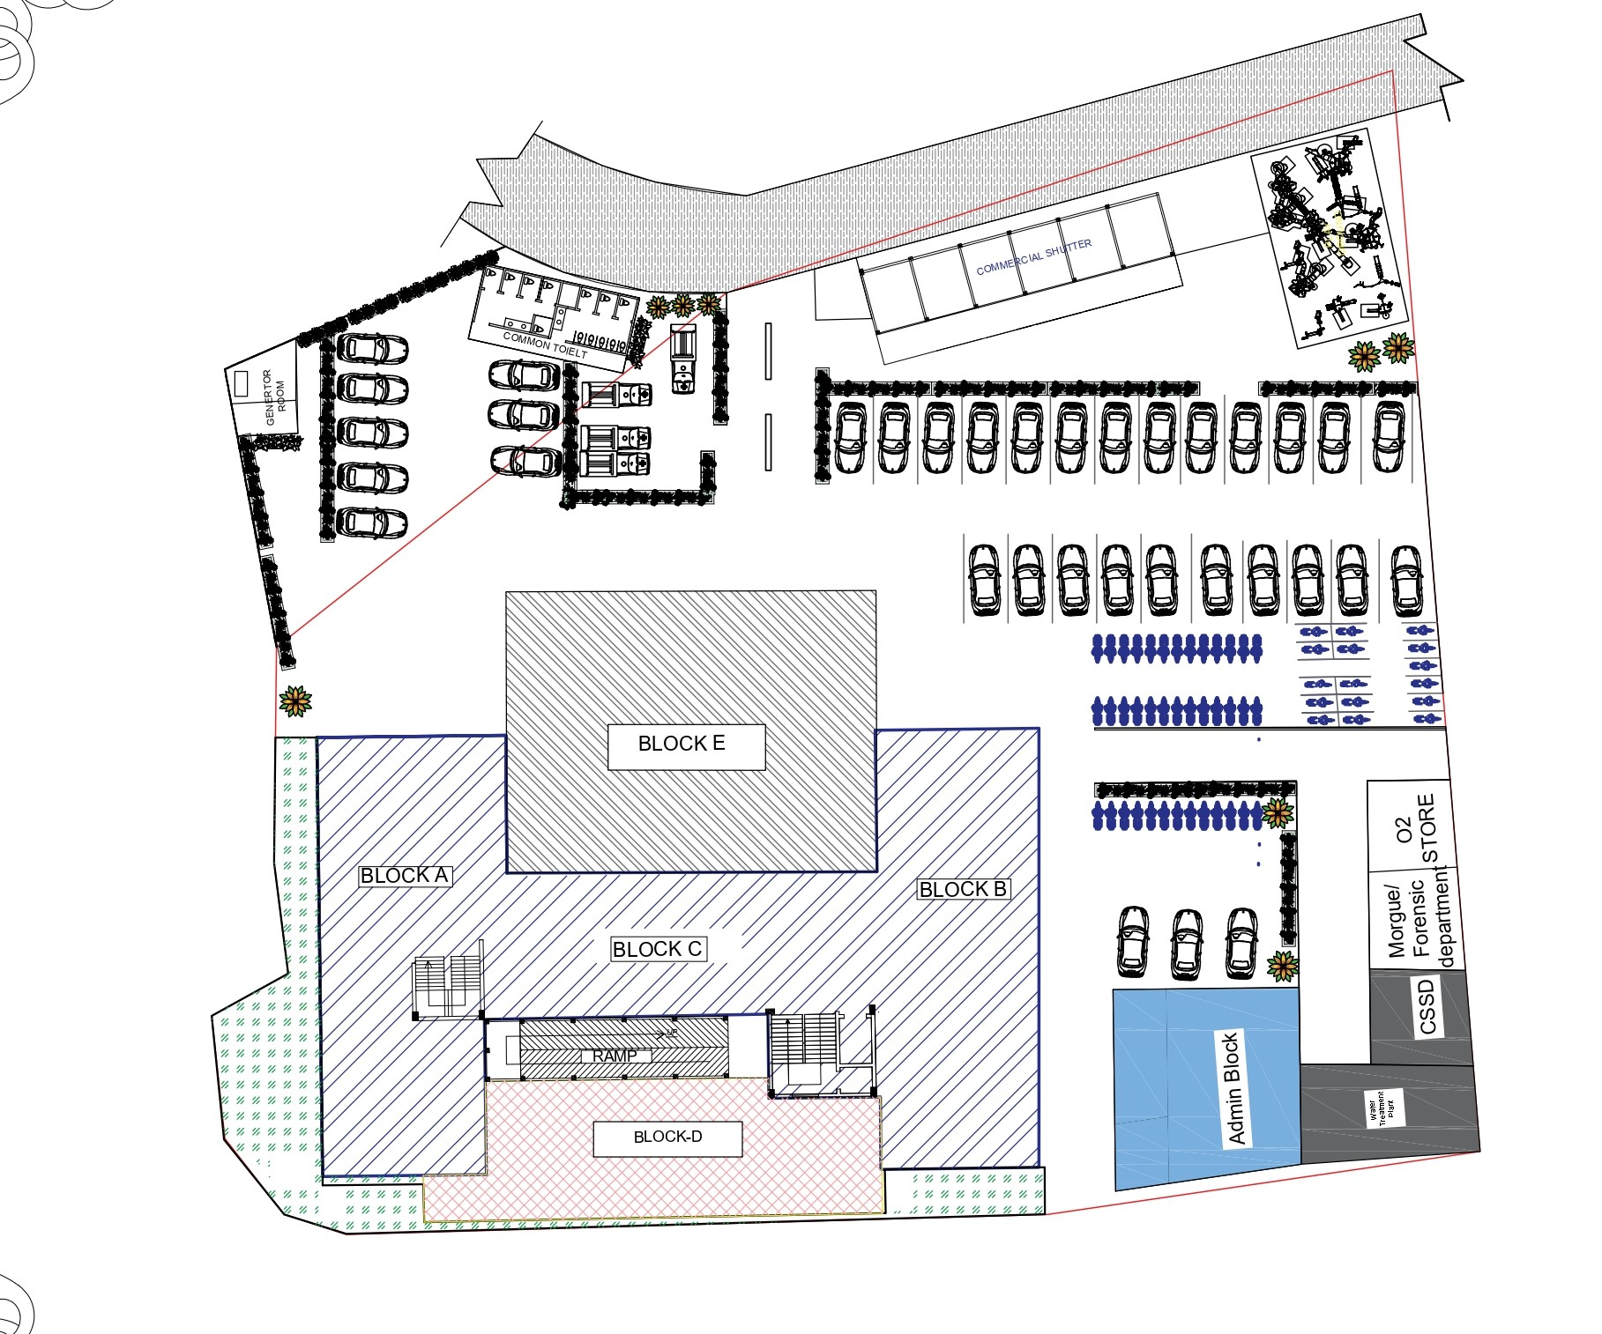
MASTER PLAN OF THE PROJECT

Slide 4
OVERVIEW OF THE PRESENTATION….
General Introduction of the Project
3D Rendered Animation of the Project
Architectural Design Features
Structural Design Features
Electrical Design Features
Sanitary and Plumbing Design Features
HVAC Design Features
Conclusion and Q/A Session

Slide 5
GENERTAL INTRODUCTION OF THE PROJECT….
Name of the project:
Location :
Purpose of the Building:
Number of Story:
Size of the Plot:
Ownership of Land:
Plinth Area of Building:
Built up Area of Building:
Floor to Floor Height of the Building:
Total Height of the Building:
Structure System of the Building:

Slide 6
GENERTAL INTRODUCTION OF THE PROJECT….
FAR:
Ground Coverage:
ROW:
Total Plinth Height:
Flooring of Building:
Provision of further extension:
Details of Parking Provision:
IEE (if applicable):

Slide 7

3D Rendered Video Animation

Slide 8
Architectural Design Features
Length and Width of Building:
Type of Staircase:
No. of Staircase:
Width of Staircase:
Dimension of Riser and Tread:
No. of Lifts:
Size of Lifts:
Provisions for Physically Disabled:
Size of Doors:
Size of Windows:
No. of Toilets:
Provision of Emergency Exit:

Slide 9
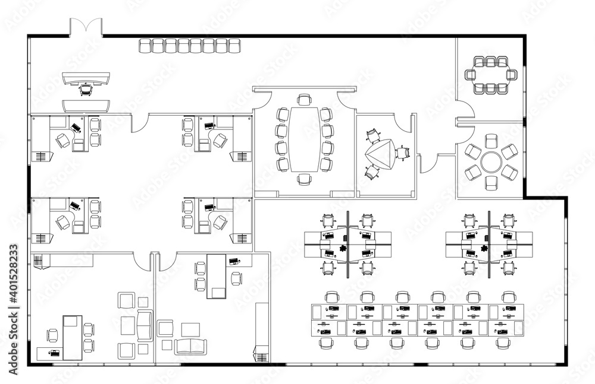
GROUND FLOOR PLAN

Slide 10
FIRST FLOOR PLAN

Slide 11
SECOND FLOOR PLAN

Slide 12
THIRD FLOOR PLAN

Slide 13
FORTH FLOOR PLAN

Slide 14
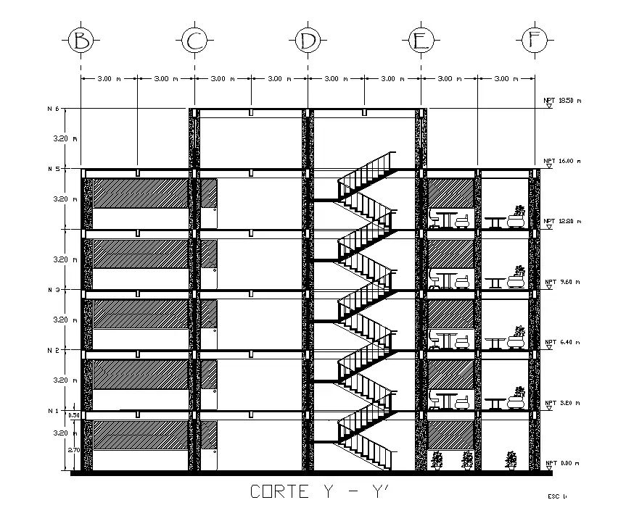
SECTIONAL VIEW OF BUILDING

Slide 15
Structural Design Features
Type of Structural System:
No. of Blocks:
No. of Columns:
Size of Beams :
Size of Columns :
Type of Foundation:
Dimension of Foundation:
Thickness of Slab:
Thickness of Shear Wall:
Type of Wall System:

Slide 16
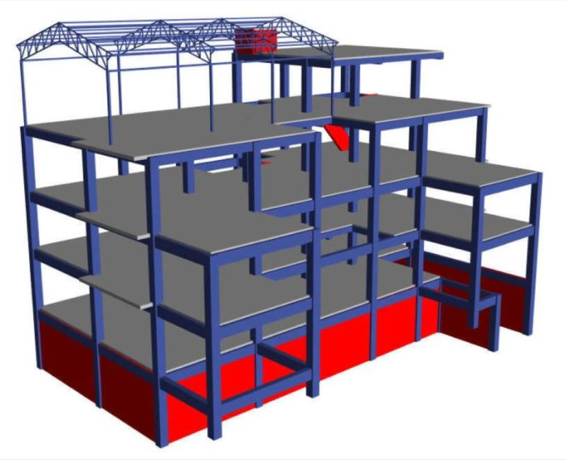
Structural Model in Software

Slide 17
Structural Design Features
Software Used For Analysis:
Method of Structural Analysis:
Bearing Capacity Considered:
Grade of Concrete:
Seismic Zoning Factor:
Importance Factor:
Loads Considered:
Fundamental Time Period:
Seismic Weight:
No. of Modes Considered:
Story Displacement:
Story Drifts:

Slide 18
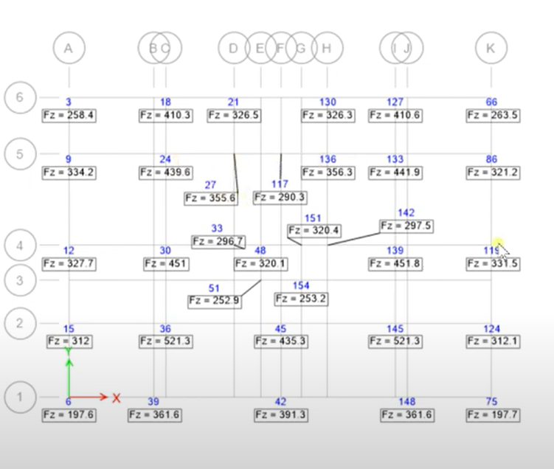
Foundation Base Reaction from Software…

Slide 19
Reinforcement Design Details…
Foundation Reinforcement :
S.N. | Type of Foundation | Size of Foundation | Main Bar Size | Distribution Bar Size | Remarks

Slide 20
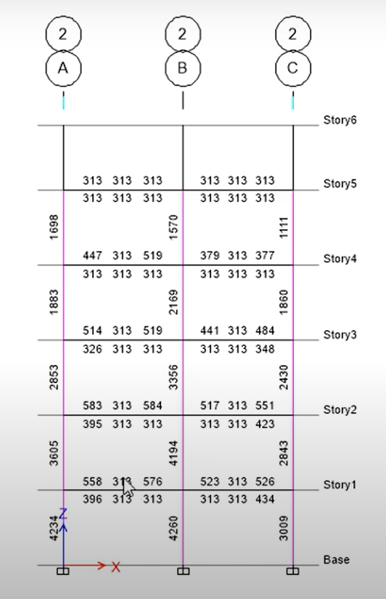
Column Area of Steel from Software

Slide 21
Reinforcement Design Details…
Column Reinforcement :
S.N. | Column ID | Size of Column | Main Bars | Distribution Bars | Remarks

Slide 22
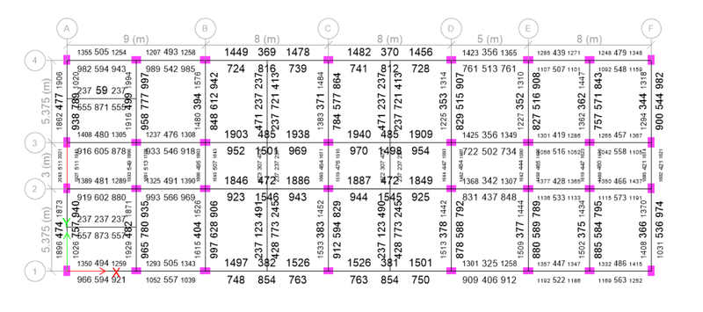
Beam Area of Steel from Software

Slide 23
Reinforcement Design Details…
Beam Reinforcement :
S.N. | Floor Level | Grid of Beam | Size of Beam | Main Bars | Distribution Bars | Remarks

Slide 24
Reinforcement Design Details…
S.N. | Description | Size of Structure | Main Bars | Distribution Bars | Remarks
1 | Slab
2 | Staircase
3 | Shear Wall

Slide 25
Electrical Design Features…
Codes Used for Design:
Size of Wire for Light Circuit:
Size of Wire for Power Circuit:
Size of Wire DB to SUB DB:
Size of Wire from MDB to DB:
Provision of Earthing:
Provision of Firefighting:
Size of MCB for Light and Power Circuit:
Total Load in Each Floor:
Power Back up System:

Slide 26
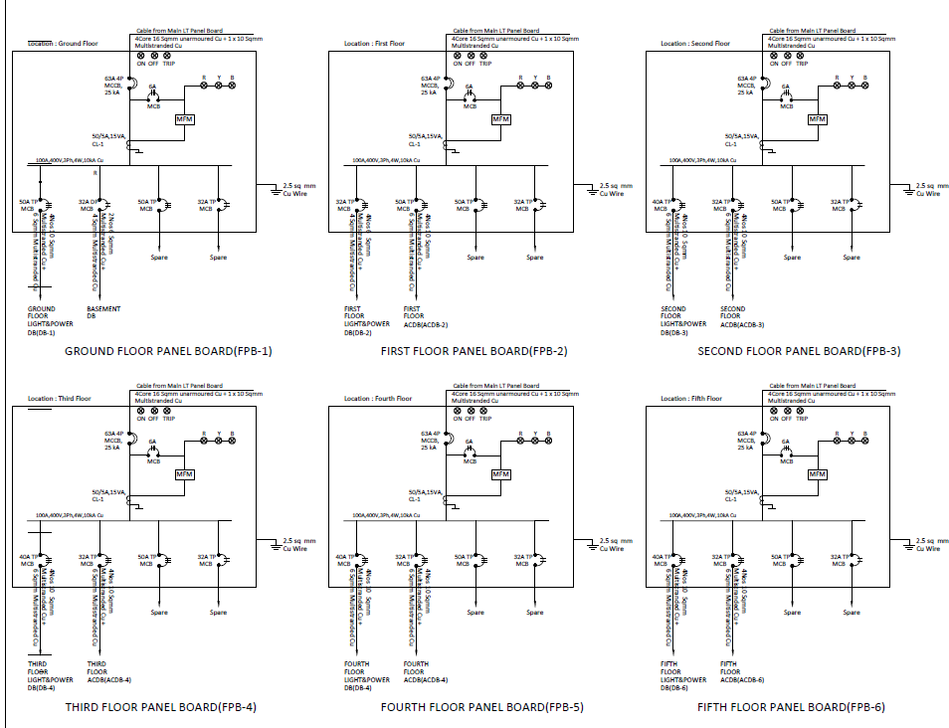
Floor Wise Panel Board…

Slide 27
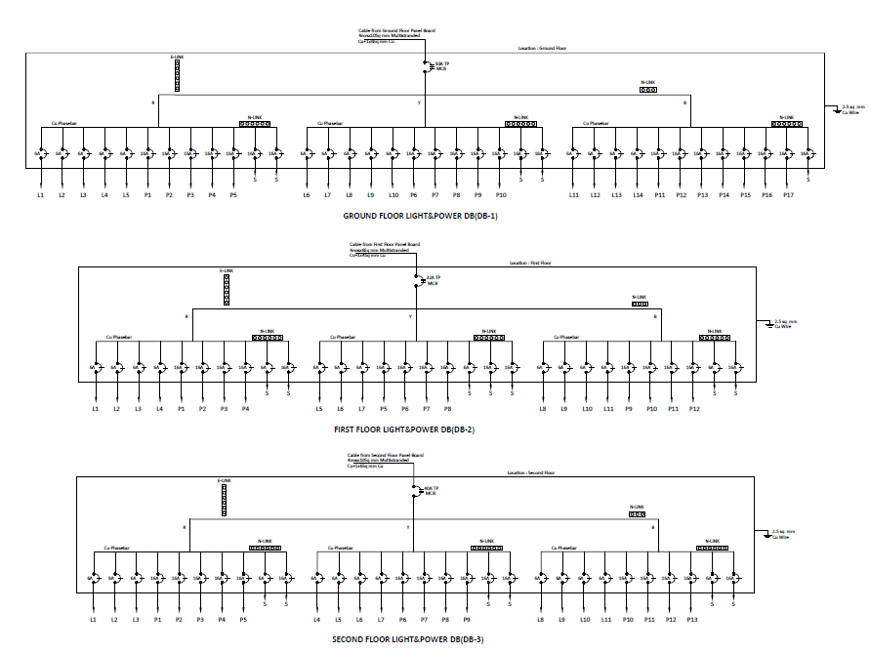
Floor Wise DB Layout Plan…

Slide 28
Sanitary And Plumbing Design…
Design Code Used:
Water Storage System Used:
Water Supply System :
Total Design Liters of Water :
Type of Water Supply Pipe used :
Size of Water Supply Pipe :
Type of Sanitary Pipe:
Size of Sanitary Pipe:
Sewage Treatment Plan:
Total Number of Toilets
Number of Users for Septic Tank:

Slide 29
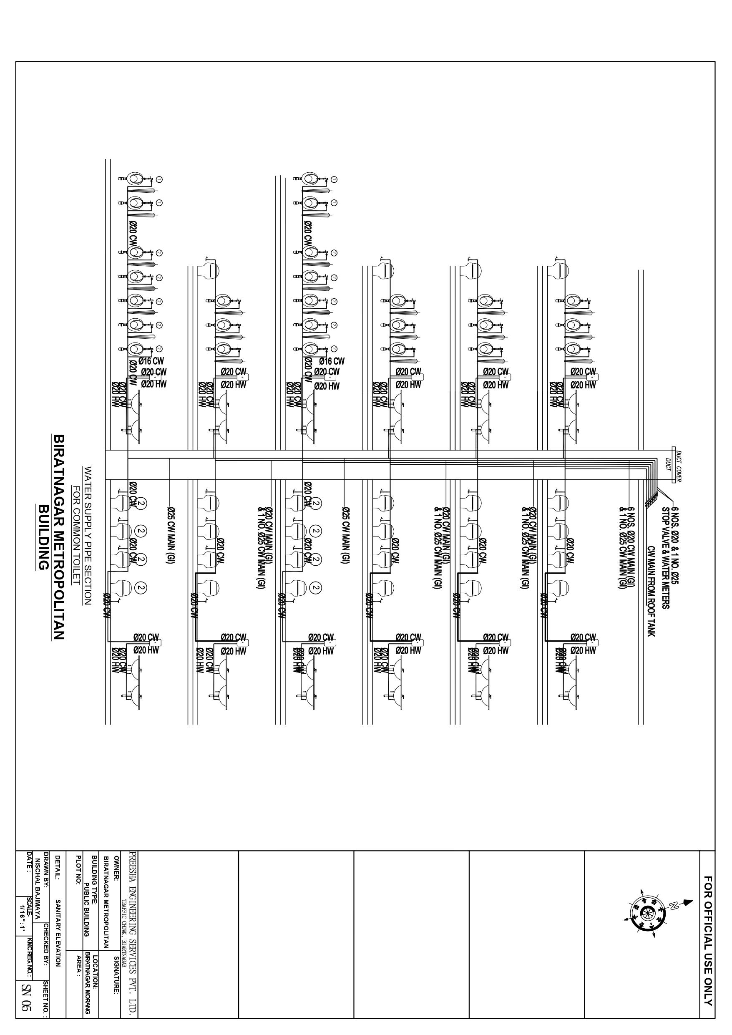
Water Supply Section View

Slide 30
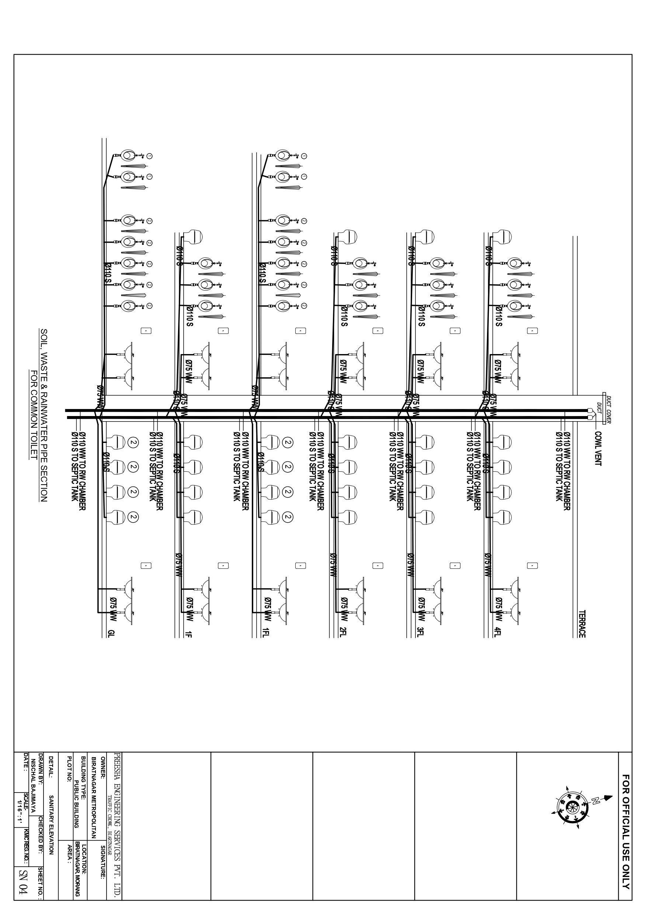
Sanitary System Section View

Slide 31
HVAC Design Features…
Design Code Used:

Slide 32
REFERENCE CODES USED….
IS 875:1998 (Part I) Code of Practice for Design Loads (Part I: Dead Loads)
IS 875:1998 (Part II) Code of Practice for Design Loads (Part II: Imposed Loads)
IS 456:2000 Plain and reinforced concrete Design Code of Practice
IS 800:2007 Code of Practice for General Construction in Steel
IS 13920:2016 Ductile Detailing of Criteria Reinforced Concrete Structures subjected to Seismic Force
IS 1893:2016 Criteria for Earthquake Resistant Construction of Buildings
IS 4326:1993 Earthquake Resistant Construction of Buildings
SP 16: Design Aids for Reinforced Concrete
NBC 105:2077: Seismic Design of Buildings in Nepal
NBC 106:2024 Architectural design Requirements
NBC 107 Electrical Design Requirements for Public Buildings
NBC 108 Sanitary and Plumbing Design Requirements
NEA Guidelines, NBC Of India 2016, IMC & NBCI
International Mechanical Code (IMC
IS4347(1967) Code of Practice for Hospital Lighting

Slide 33
Q/A Session…
S.N. | Name of Designer/Engineer | NEC No. | Designation
1. |  |  | Architect
2. |  |  | Structural Engineer
3. |  |  | Electrical Designer
4. |  |  | Sanitary and Plumbing Designer
5. |  |  | HVAC Designer

Slide 34
Thank you…
[Name of Project]

